Slide 1
Phone Price Prediction
Plachetzky Nicolai, Kiri Nertil, Puka Benjamin, Vural Zeliha, Iliagouev Alon

Slide 2






Goal
Automated way to decide on price ranges for new Phones
Notes:
Szenario:
You are a company.
You produce many devices per year.
You have a choice:
Set a price based on feeling.
Set a price based on logic and maths.
Answer is obvious.
Our Model Provides the logic and does the calculations any phone company needs.

Slide 3
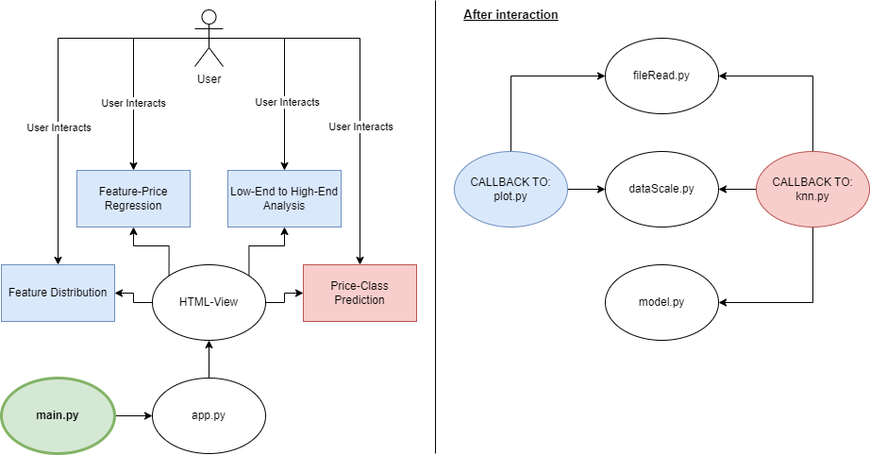
Program Architecture

Slide 4
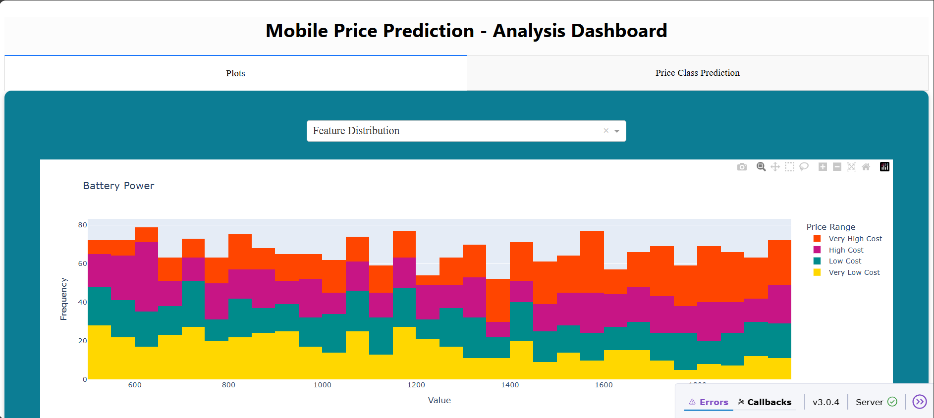
Notes:
Amount of Datapoints (separated in price ranges) per feature value (or value range)

Slide 5
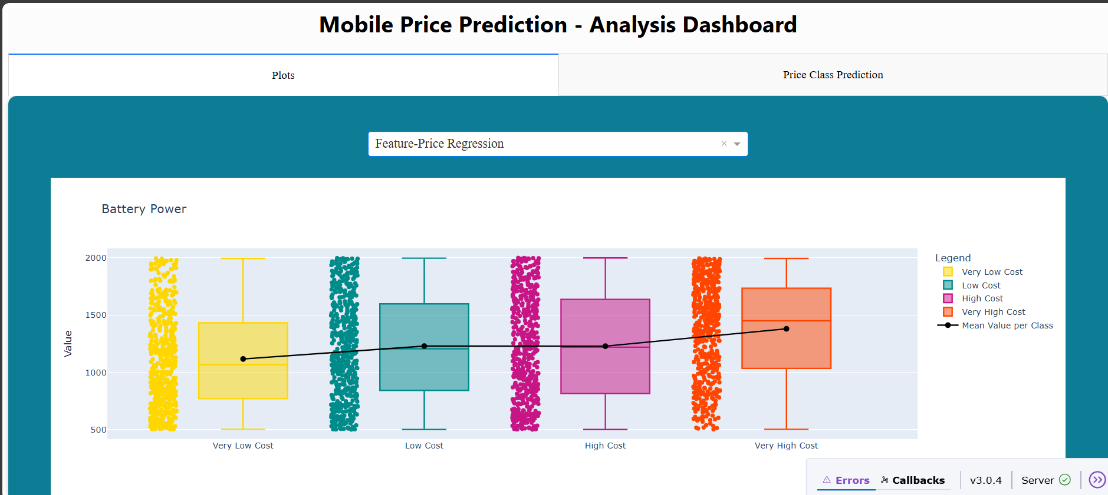
Notes:
Basically same as before but different visualisation and a bit easier to compare

Slide 6
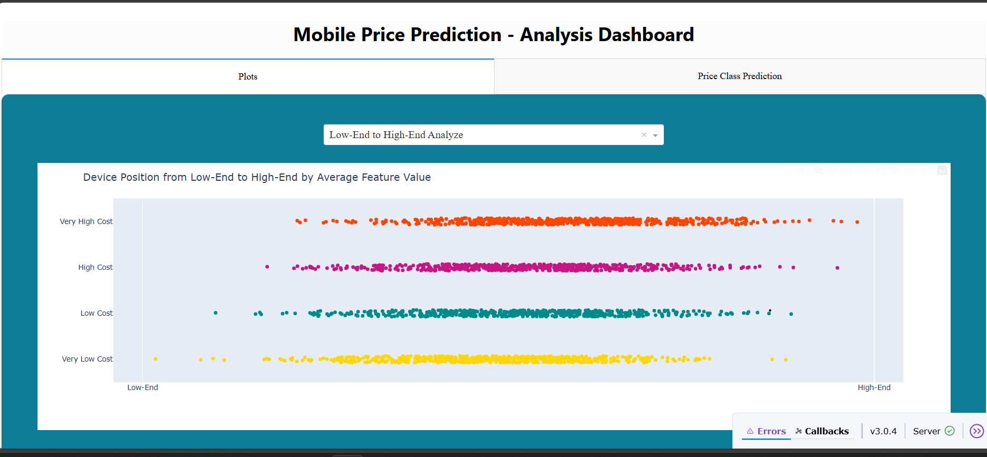
Notes:
Scaled all values for each datapoint and took average feature value. Then separated in price ranges

Slide 7
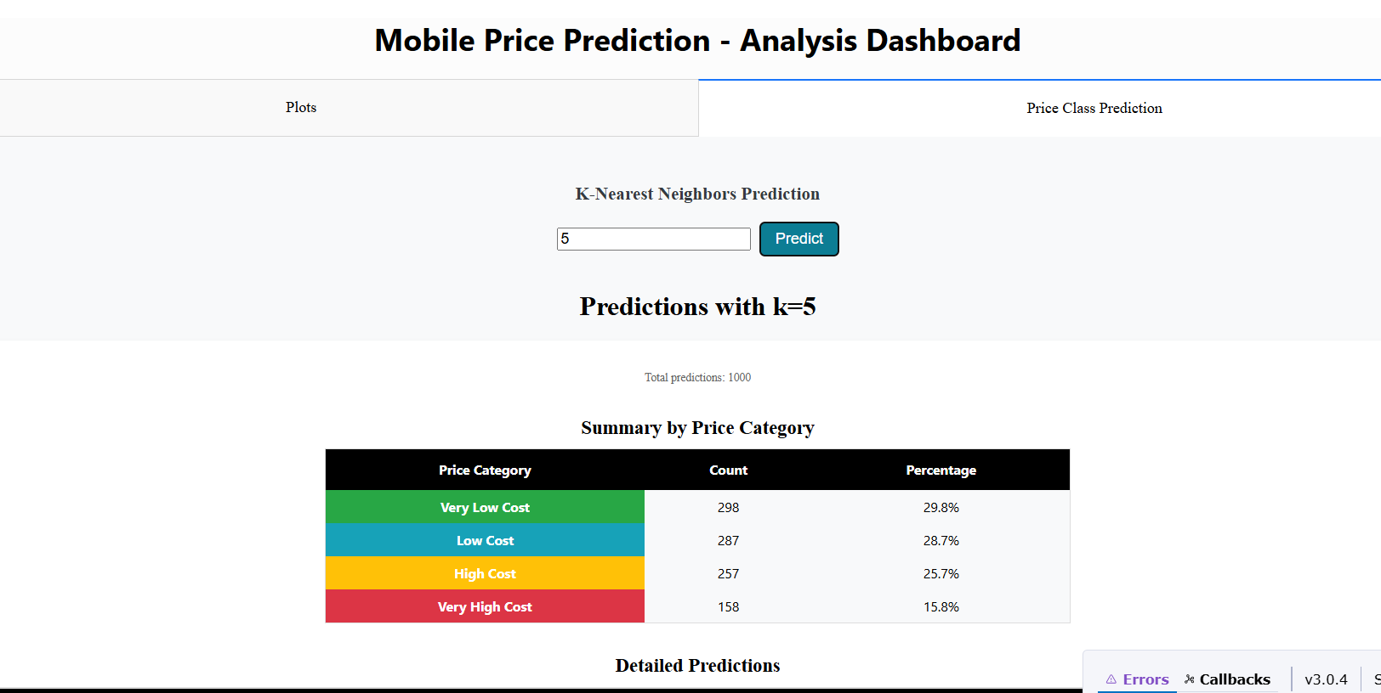
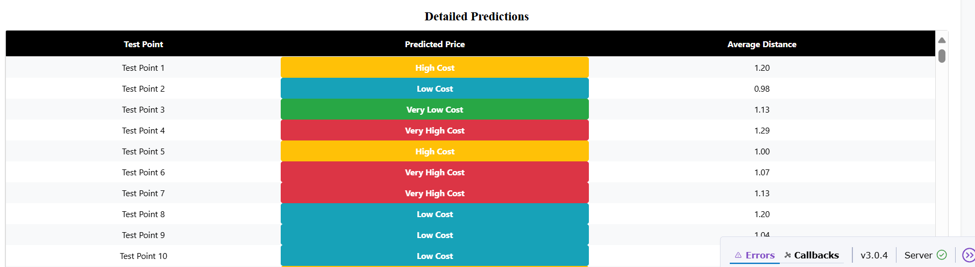

Slide 8
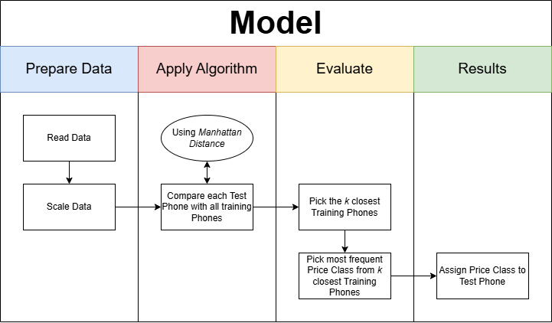
Using Euclidean
distances
Notes:
Euclidean distance:
Square root of the sum of squared differences between the feature values of a test point and a training point
Explain with Scenario: phone 1: ram 8gb and storage 64gb
phone 2: ram 4gb and storage 128gb
Step-by-step calculation:
Difference in RAM: 8−4=48 - 4 = 48−4=4 → Squared: 42=164^2 = 1642=16
Difference in Storage: 64−128=−6464 - 128 = -6464−128=−64 → Squared: (−64)2=4096(-64)^2 = 4096(−64)2=4096
Sum of squared differences: 16+4096=411216 + 4096 = 411216+4096=4112
Euclidean distance: 4112≈64.11\sqrt{4112} \approx 64.114112​≈64.11

Slide 9
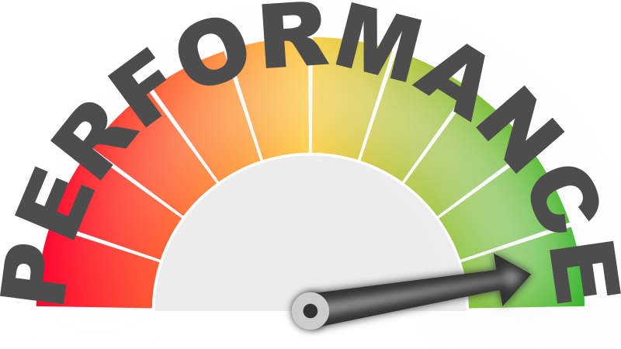
Technical Perspective
Challenges
Slow on large datasets
No learning phase
Why it does not matter
Datasets are always small
Can not learn on fluctuating market data
Notes:
How would this model be deployed in production?
What are the technical challenges of deploying KNN?
Slow prediction time on large datasets
No learning phase → needs full training data at runtime
Why it does not matter
Datasets are always small since there are not millions of phones on the market
Can not learn on fluctuating market data
Deployment Strategy:
- RESTful API development
- Cloud infrastructure
- Caching mechanisms

Slide 10
Domain Expert Perspective
Mistakes & Risks
Misclassification
Constant monitoring of trends
Solutions
Double checking
Simulate Predictions early
Notes:
Is the model accurate and interpretable for business use?
Does it help decision-makers (e.g., marketing or pricing teams)?
What are possible mistakes or risks?
Misclassifying high-end phones could cause pricing errors
Needs constant monitoring of new phone trends and feature shifts
How do you validate it?
Double check of Price Class by an Expert
Simulate Predictions with speculated outcomes

Slide 11
Societal Perspective
Dangers
Biases in data
Over-reliance
Consumer trust
Positive
Help smaller companies
Fast classification
Notes:
What happens if the model is used at large scale (e.g., by e-commerce platforms)?
Possible dangers:
Biases in data = unfair predictions (e.g., low RAM always → cheap)
Over-reliance on automated tools → humans stop verifying
Affects consumer trust if mispriced products lead to complaints
Positive impact?
Can help smaller vendors set better prices
Enables faster product classification

